Slide 1
Pre-conception care, antenatal care and prenatal diagnosis

Slide 2
Pre conception Care

Slide 3
Evidence Base?
There is clear evidence that the initiation of preconception counselling and care for women with some chronic health conditions, e.g., diabetes, will positively impact pregnancy outcomes
For women with a history of a poor pregnancy outcome in the past, pre- or inter-conceptional intervention strategies have been demonstrated to be effective

Slide 4
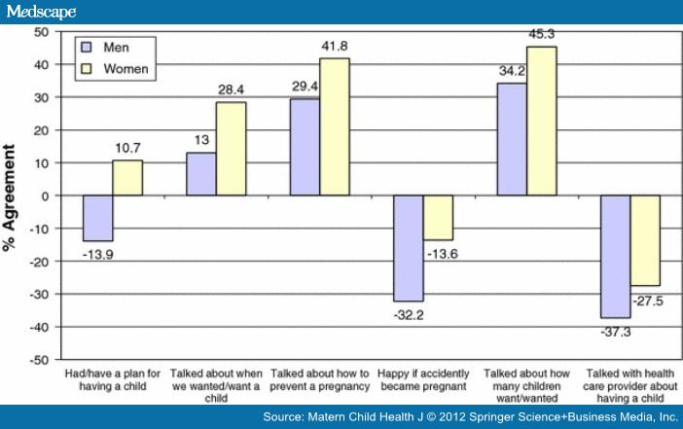
Is it being done?

Slide 5
Goals of preconception care
Improved knowledge, attitudes and behaviours of men and women related to preconception health
Assure that all women of childbearing age receive preconception care services
(i.e., evidence-based risk screening, health promotion, and interventions) that will enable them to enter pregnancy in optimal health

Slide 6
Goals
Reduce risks indicated by a previous adverse pregnancy outcome
through interventions during the inter-conception period, which can prevent or minimize health problems for a mother and her future children
Reduce the disparities in adverse pregnancy outcomes.

Slide 7
Issues to consider
Age related risks
Diet
Folic acid
Weight
Lifestyle factors
Domestic abuse/violence
Jobless male partner
Cervical screening
Infection screening
Genetic counselling
Pre-existing medical conditions
Contraception

Slide 8
Pre pregnancy Health Promotion
Local health promotion arrangements need to include the
provision of the following information for parents:
What becoming a parent might be like and the impact on wider family/adult relationships.
The importance of:
pre-conceptual folic acid
minimising intake of alcohol
not using recreational drugs
not smoking during pregnancy and having a smoke-free environment
pre-pregnancy rubella immunisation, and
seeing a healthcare professional as early in pregnancy as possible.

Slide 9



Slide 10


Smoking, Alcohol, Drugs
There are significant risks to the health, and life, of a baby if the mother smokes.
These include the risk of:
miscarriage,
premature birth and stillbirth,
placental abnormalities,
low birthweight
after birth, sudden infant deaths. 1/3 of perinatal deaths linked to smoking.
There is also a significant risk to fetal development with women misusing drugs or alcohol

Slide 11
Specific preconception care -I
Discussion with regards to the impact of drug treatment on the unborn child
Need to change medication
Such conditions will include:
epilepsy,
schizophrenia,
hypertension and
bi-polar affective disorders

Slide 12
Specific preconception care - II
Optimising treatment and health before becoming pregnant
Need to ensure good health while pregnant as it may worsen the health status
Such diseases include:
A history of embolism,
Epilepsy
Diabetes
Heart disease
SCD

Slide 13
Specific preconception care - III
Genetic counselling and screening
Previous genetic diseased affected child
Downs’ syndrome
Pre implantation diagnosis
Con-sanguinous marriages
Haemoglobinopathies
Prospective or existing parents with a family history of a genetic disorder, and those who are concerned about familial disease or disabilities.

Slide 14
Folic acid
Supplementation with folic acid is one of the most significant preventative interventions for NTD available in the preconceptual/antenatal period
Periconceptional Folic Acid and Food Fortification in the Prevention of
Neural tube defects
Royal College of Obstetricians and Gynaecologists (2003)
Diet alone (e.g. green vegetables, fortified cereals) does not reliably supply adequate folic acid.

Slide 15
Folic acid
There is also some evidence suggesting risk of other structural anomalies, i.e cardiac or craniofacial abnormalities, may also be ↓ by folate supplementation.
Finnell R, Shaw G, Lammer E et al. (2004) Gene-nutrient interactions: importance of
folates and retinoids during early embryogenesis.
Toxicol Appl Pharmacol 198(2), 75–85
All women should take at least 400mcg/day or 5mg whilst trying to become pregnant and for at least the first three months of pregnancy to reduce the risk of NTD.

Slide 16
Folic acid
Where either partner has a NTD or has already had a pregnancy affected by NTD, or who are at a higher risk should be prescribed 5 mg/day.
Higher risk of NTD is associated with:
Liver disease, mal-absorption (e.g. coeliac disease),
Family history of NTD
Anti-epileptic medication
Renal dialysis
Diabetes (type 1 or 2)
Sickle cell anaemia or thallassaemia
Women with a BMI > 30 kg/m²

Slide 17
Weight
Obese (BMI ≥30) women should lose weight
before becoming pregnant. Associated ↑ risk of
Neural tube defect
Preterm delivery
Gestational diabetes
Labour dystocia and shoulder dystocia
Anaesthetic complications
Caesarean delivery
Hypertension
Thromboembolic disease

Slide 18
Other issues
Patient not in optimal health would require
-contraception
- other members of staff in the hospital or referral to other centers for optimal treatment
- dietary advise and folic acid
- vaccination and other RCH services should be offered.

Slide 19
ANTENATAL CARE (ANC)

Slide 20

Antenatal care with a midwife

Slide 21
Aims and objectives of ANC
Is essentially a screening test
Screening for maternal and fetal disorder on each visit
Diagnosis and management of pre-existing maternal medical disorder
Early identification of obstetric complications
Planning for labour and delivery including other RCH programmes in the postpartum e.g. FP
Provision of IEC

Slide 22
Screening
Anaemia – Booking and 28 weeks – reference value <11g/dl and 10.5g/dl respectively
Blood group and Rhesus compatibility
Rh Negative – anti D prophylaxis at 28 weeks
Haemoglobinopathies – Booking
Treatment for malaria

Slide 23
Infection Screen
Urine MCS
Hepatitis B
Syphyllis
HIV
Rubella
Non routine: BV, Chlamydia, CMV, Toxoplasmosis, Beta haemolytic streptococus

Slide 24
ANC INFORMATION
pregnancy is a normal physiological process and that, as such, any interventions offered should have known benefits and be acceptable to pregnant women.
Pregnant women should be offered information based on the current available evidence together with support to enable them to make informed decisions about their care.
Booking (ideally by 10 weeks): breast feeding, pelvic floor exercise, folic acid400 micrograms per day or 5mg., vit D rich food, blood and urine tests, dating scan, prophylaxis: malaria, tetanus; fe supplements,
Maternity services should have a system in place whereby women carry their own case notes.

Slide 25
ANC INFORMATION
Vitamin A supplementation (intake above 700 micrograms) might be teratogenic and should therefore be avoided.
Prescription medicines should be used as little as possible during pregnancy and should be limited to circumstances in which the benefit outweighs the risk
Do moderate course of exercise and have sexual intercourse
Increased vaginal discharge is a common physiological change that occurs during pregnancy. If it is associated with itch, soreness, offensive smell or pain on passing urine there may be an infective cause and investigation should occur.

Slide 26
ANC INFORMATION
Although only a small number of women are diagnosed with syphilis during pregnancy, the vertical transmission to the fetus has serious consequences.
This transmission to the fetus can easily be prevented by treatment of the mother with antibiotics.
Similarly neonatal tetanus is rare because of effective vaccination protocol of T.T during pregnancy; this should continue to avoid resurgence

Slide 27
Frequency of antenatal appointments
A schedule of antenatal appointments should be determined by the function of the appointments.
For a woman who is nulliparous with an uncomplicated pregnancy, a schedule of 10 appointments should be adequate.
For a woman who is parous with an uncomplicated pregnancy, a schedule of 7 appointments should be adequate.
There are several classifications of antenatal care; if the women have community care, then the lead clinician would be the community midwife.

Slide 28
Focused antenatal care
Evidence-based care
Client-centered care
Goal-directed care
Provided by skilled health providers
Emphasis on quality rather than frequency of visits
Requires the use of a triage form
Only qualified mothers(no abnormal condition) will have only 4 visits
1st visit within 12 weeks of pregnancy; 2nd visit at 26 weeks; 3rd visit at 32 weeks; 4th visit at 36-38weeks; if labour did not occur patient to return at 41weeks

Slide 29
Prenatal Diagnosis

Slide 30
Downs syndrome screening
>14 weeks to 20 weeks:
Triple or Quadruple test)
B HCG,
Alpha fetoprotein,
Inhibin
estriol
When it is not possible to measure nuchal translucency, owing to fetal position or raised body mass index:
Women should be offered serum screening (triple or quadruple test) between 15 weeks 0 days and 20 weeks 0 days.

Slide 31
Screening for structural anomaly 18-20 week scan
The purpose of the scan is to
identify fetal anomalies and allow:
reproductive choice (termination of pregnancy)
parents to prepare (for any treatment /disability/palliative care/termination of pregnancy)
managed birth in a specialist centre
intrauterine therapy.

Slide 32
Anomaly scan and Downs’ syndrome
Soft markers should not be used as surrogate for Downs’ syndrome
Choroid plexus cyst
Echogenic foci in the heart
Echogenic bowel
Short femur
Renal dilatation - Pyelectasis
It should not be used to readjust the Priori risk for T21

Slide 33



Black or White – we all deserve the Best

